Slide 1
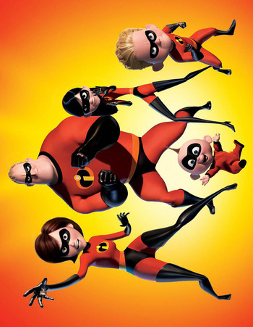
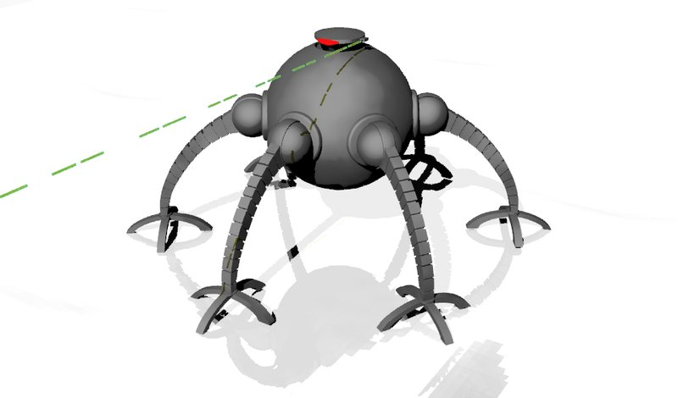
can you help
The incredible
save the world?
start
back to start
back to start
+3
key expressions:
game rules:
you must land on the square with the ladder to go up or down.
you must use English.
you must land on finish to win.
-2
-2
+2

