Slide 1
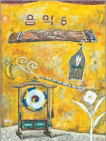
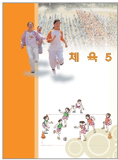
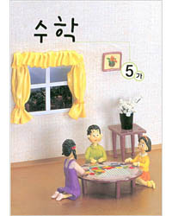
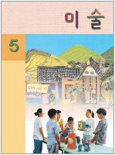
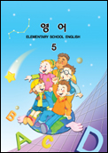
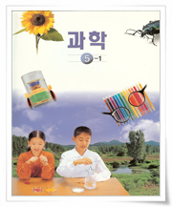
Lesson 9. What Day Is It Today?
What day is it today?
It’s ____ . I have ____ on ____.
A
A
Start!
Finish!
2 steps
ahead!
Monday
Thursday
Wednesday
Tuesday
Saturday
D
D
Monday
Tuesday
Miss
a turn!
3 steps
ahead!
Miss
a turn!
Wednesday
Friday
Tuesday
Tuesday
2 steps
back!
Thursday
Thursday
Monday
Wednesday
Saturday
Wednesday
3steps
back!
B
B
C
C
Thursday
Wednesday
Friday
Saturday
Tuesday
Saturday
Go back to the start!

