Slide 1
앵그리버드게임
앵그리버드 알파벳 게임

Slide 2
How to play
상대팀에게 폭탄을 골라 공격하세요!
가끔 돼지들의 반격이 있을 때도 있습니다.
( 매우 드무나 그들의 공격은 매우 강합니다!)
먼저 다 부순 팀이 승리!
그러면 폭탄을 던져볼까요?

Slide 3
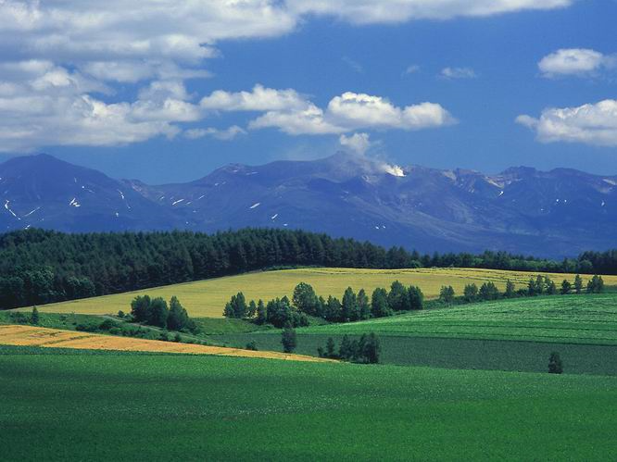
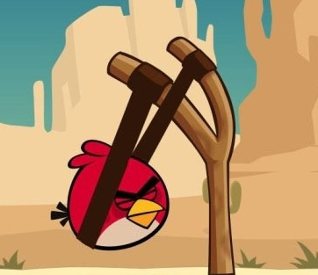
A
Pigs Win!
Go!

Slide 4
a
Students Win!
Go!

Slide 5
A
B
C
D
E
F
G
H
I
J
K
L
M
N
O
P
Q
R
S
T
U
V
W

Slide 6
X
Y
Z
a
b
c
d
e
f
g
h
i
j
k
l
m
n
o
p
q
r
s

Slide 7
t
u
v
w
x
y
z

Slide 8
Q. I like _________ baseball.
vs
Playing

Slide 9
6

Slide 10
Q. I like ____♪____.
vs
singing

Slide 11
4

Slide 12
Q. My favorite subject ___ art.
vs
is

Slide 13
!!!!!
돼지들의 역습!!!

Slide 14
12

Slide 15
Q. My favorite _______ is math.
vs
subject

Slide 16
6

Slide 17
Q. What’s your ________ subject?
vs
favorite

Slide 18
4

Slide 19
Q. 과학
vs
Science

Slide 20
3

Slide 21
Q.I like __________science books.
vs
reading

Slide 22
!!!!!!
결정적인 공격!

Slide 23
16

Slide 24
Q. 미술
vs
art

Slide 25
5

Slide 26
Q. 체육
vs
P.E.

Slide 27
!!!!!
돼지들의 역습!!!

Slide 28
10

Slide 29
Q. I like ________ the piano.
vs
Playing

Slide 30
3

Slide 31
Q. What’s your favorite subject?
vs
My favorite subject is ( ).

Slide 32
5

Slide 33
Q. What’s your favorite food?
vs
My favorite food is ( ).

Slide 34
6

Slide 35
Q. What’s your favorite sport?
vs
My favorite sport is ( ).

Slide 36
!!!!!
돼지들의 역습!!!

Slide 37
12

Slide 38
Q. I like _________ pictures.
vs
drawing

Slide 39
!!!!!
돼지들의 역습!!!

Slide 40
16

Slide 41
Q. What’s your favorite song?
vs
My favorite song is ( ).

Slide 42
6

Slide 43
Q. 음악
vs
Music

Slide 44
5

Slide 45
Q. I like _________ Pizza.
vs
eating

Slide 46
3

Slide 47
Q. 영어.
vs
English

Slide 48
4

Slide 49
Q. 수학
vs
Math

Slide 50
5

Slide 51
Q. 국어
vs
Korean

Slide 52
6

Slide 53
Q. 사회
vs
Social studies

Slide 54
3

Slide 55
Q. B l l A B A E S
vs
Baseball

Slide 56
4

Slide 57
Q. T R A
vs
Art

Slide 58
4

Slide 59
Q. c i m s u
vs
Music

Slide 60
!!!!!
결정적인 공격!

Slide 61
16

Slide 62
Q. e n s c I c e
vs
science

Slide 63
4

Slide 64
Q. a v r t i e f o
vs
favorite

Slide 65
6

Slide 66
Q. K E I L.
vs
Like

Slide 67
3

Slide 68
Q. 나는 별 보는 것
좋아해.(186 p)
vs
I like watching stars.

Slide 69
5

Slide 70
Q. 나의 가장 좋아하는 과목은 미술이야.
vs
My favorite subject is art.

Slide 71
6

Slide 72
Q. 나는 매일 그림을
그려.
vs
I draw pictures every day.

Slide 73
!!!!!
돼지들의 역습!!!

Slide 74
12

Slide 75
Q. 나는 기타 치는 게
좋아.
vs
I like paying the guitar.

Slide 76
3

Slide 77
Q. 가장 좋아하는 스포츠가 뭐야?(185p)
vs
What is your favorite sport?

Slide 78
4

Slide 79
Q. 응, 맞아.
vs
Yes, I do.

Slide 80
4

Slide 81
나는 노래하는 게
좋아.
vs
I like singing.

Slide 82
3

Slide 83
Q. 과목
vs
subject

Slide 84
5

Slide 85
Q. fevorite
vs
Favorite

Slide 86
4

Slide 87
Q. Sciance
vs
Science

Slide 88
!!!!!
돼지들의 역습!!!

Slide 89
14

Slide 90
Q. suvject
vs
subject

Slide 91
4

Slide 92
Q. Evary day
vs
Every day

Slide 93
3

Slide 94
Q. I like _________ TV.
vs
watching

Slide 95
6

Slide 96
Q. My favorite subject is ___사회___.
vs
Social studies

Slide 97
!!!!!
돼지들의 역습!!!

Slide 98
14

Slide 99
Q. 나의
vs
My

Slide 100
4

Slide 101
Q. I like _________ sports.
vs
Playing

Slide 102
!!!!!
돼지들의 역습!!!

Slide 103
18

Slide 104
Q. Lesson 11. ___________________
vs
My favorite subject is Science.

Slide 105
!!!!!
결정적인 공격!

Slide 106
18

Slide 107
Q. D A R E
B K O O S
vs
Read books.

Slide 108
6

Slide 109
Q. sport/ baseball / is / My favorite / .
vs
My favorite sport is base ball.

Slide 110
4

Slide 111
Q. like / I / baseball / playing / .
vs
I like playing baseball.

Slide 112
6

Slide 113
Q. subject / art /
My favorite / is / .
vs
My favorite subject is art.

Slide 114
5

Slide 115
Q. drawing / I / pictures / like / .
vs
I like drawing pictures.

Slide 116
!!!!!
돼지들의 역습!!!

Slide 117
14

Slide 118
Q. I like _________ games.
vs
Playing

Slide 119
4

Slide 120
Q. My favorite subject is music.
I like _________.
vs
singing

Slide 121
!!!!!!
돼지들의 역습!!!

Slide 122
12

Slide 123
Q. My favorite subject is art.
I like ______ pictures.
vs
drawing

Slide 124
!!!!!
돼지들의 역습!!!

Slide 125
14

