Slide 1
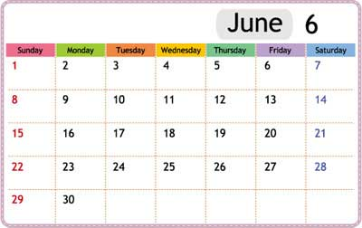
What day is it today?
It’s Monday

Slide 2
What day is it today?
It’s Sunday

Slide 3
What day is it today?
It’s Thursday

Slide 4
What day is it today?
It’s Tuesday

Slide 5
What day is it today?
It’s Wednesday

Slide 6
What day is it today?
It’s Saturday

Slide 7
What day is it today?
It’s Friday

Slide 8
What day is it today?
It’s Monday

Slide 9
What day is it today?
It’s Friday

Slide 10
What day is it today?
It’s Sunday

Slide 11
What day is it today?
It’s Saturday

Slide 12
What day is it today?
It’s Thursday

Slide 13
What day is it today?
It’s Tuesday

