Slide 1
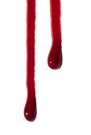
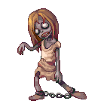
Zombie Virus Game

Slide 2
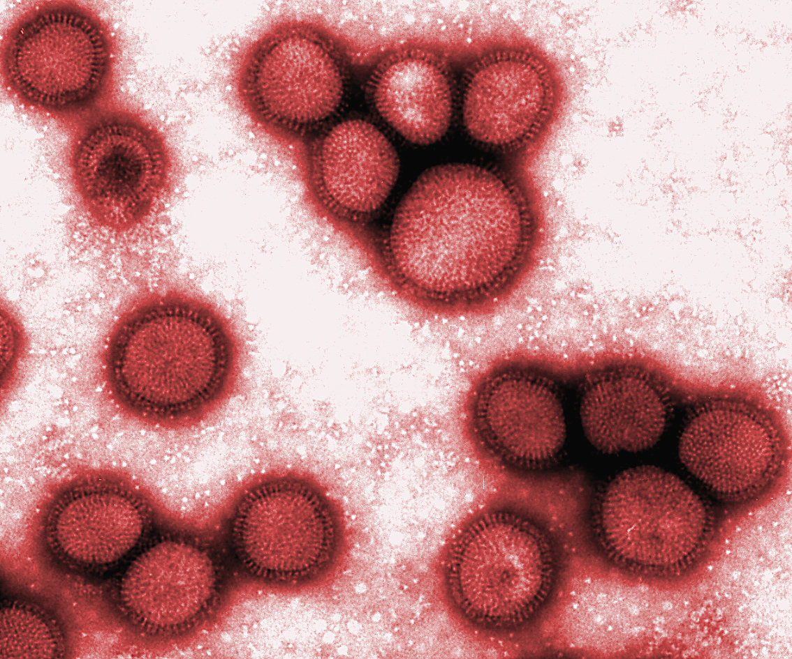
Virus

Slide 3
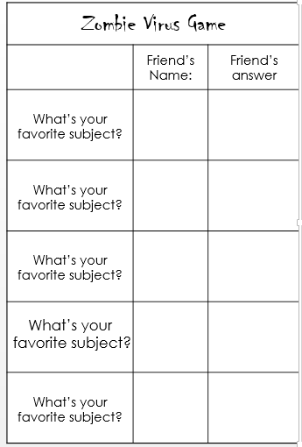
Rules
Each student gets a piece of paper, like this:

Slide 4
Rules
I have given out cards which say ‘human’ or ‘zombie’.
There are 4 zombies.

Slide 5
Rules
Speak to 5 DIFFERENT students.
Ask them the question:
What’s your favorite subject?

Slide 6
Rules
Hi Mario! I What’s your favorite subject?
My favorite subject is P.E.
P.E.
Mario

Slide 7
Rules
Hi Peach!
What’s your favorite subject?
My favorite subject is English.
P.E.
Mario
English.
Peach

Slide 8
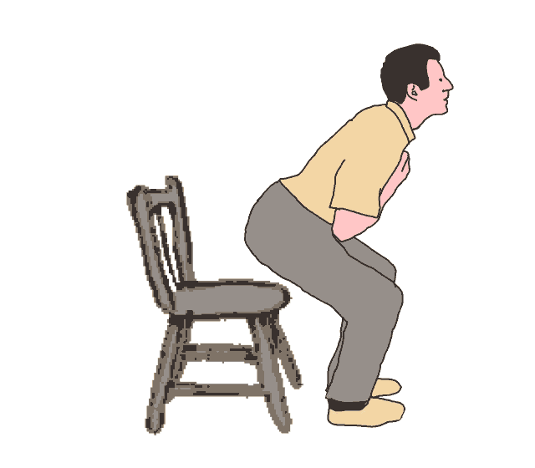
Rules
When you have finished, sit down.
Mario
P.E.
Peach
English
Kirby
Science
Tom
History
Jerry
P.E.

Slide 9
Humans
If you have a zombies name on your paper, you have died.
If you have no zombies on your paper, you win!
REMEMBER: If you think they are a zombie, don’t ask them the question!

Slide 10
Zombies
There are 4 zombies.
The winning zombie is the zombie who kills the most humans.

Slide 11
Dialogue
Q: What’s your favorite subject?
A: My favorite subject is __________.
E.g. English, Science, Math, Art, Social Studies, P.E., Korean.

